Slide 1

Quantum Random Number Generator (QRNG)
Student Name: Moayed Jamal Eshbeni
Student ID: 2210249584
Course: EC580 Special Topics in Digital Systems
University of Tripoli

Slide 2

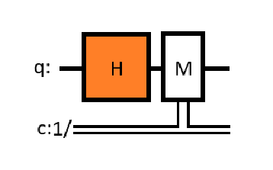
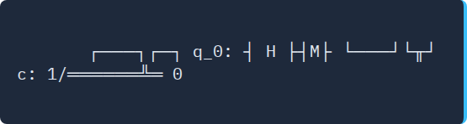
Quantum Circuit Diagram
Explanation:
The qubit starts in the state |0⟩.
A Hadamard gate creates a superposition.
Measuring the qubit produces either 0 or 1 with equal probability (50%).

Slide 3
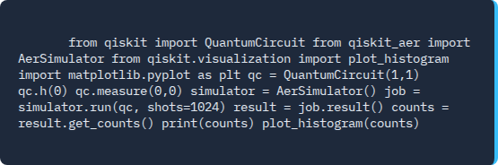


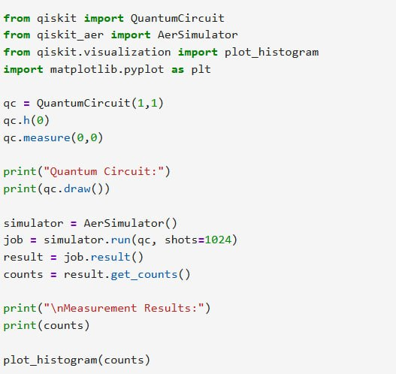
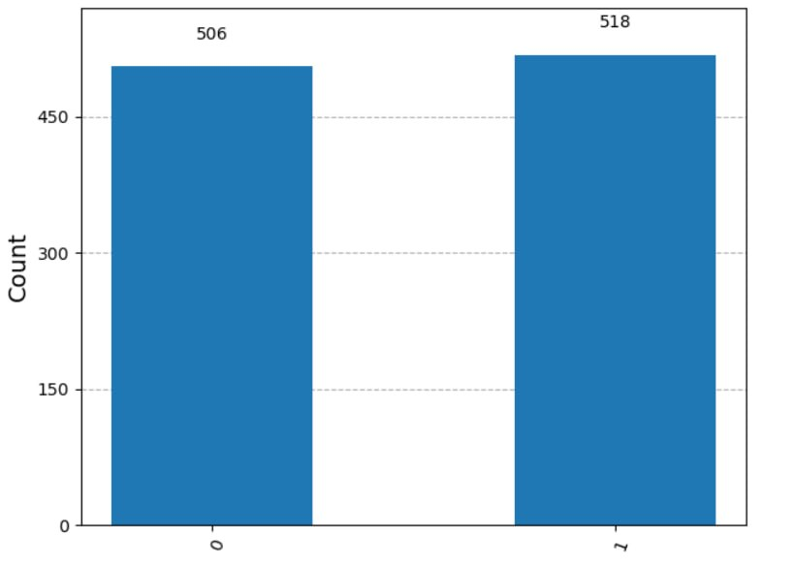
Qiskit Python Code & Results

Slide 4

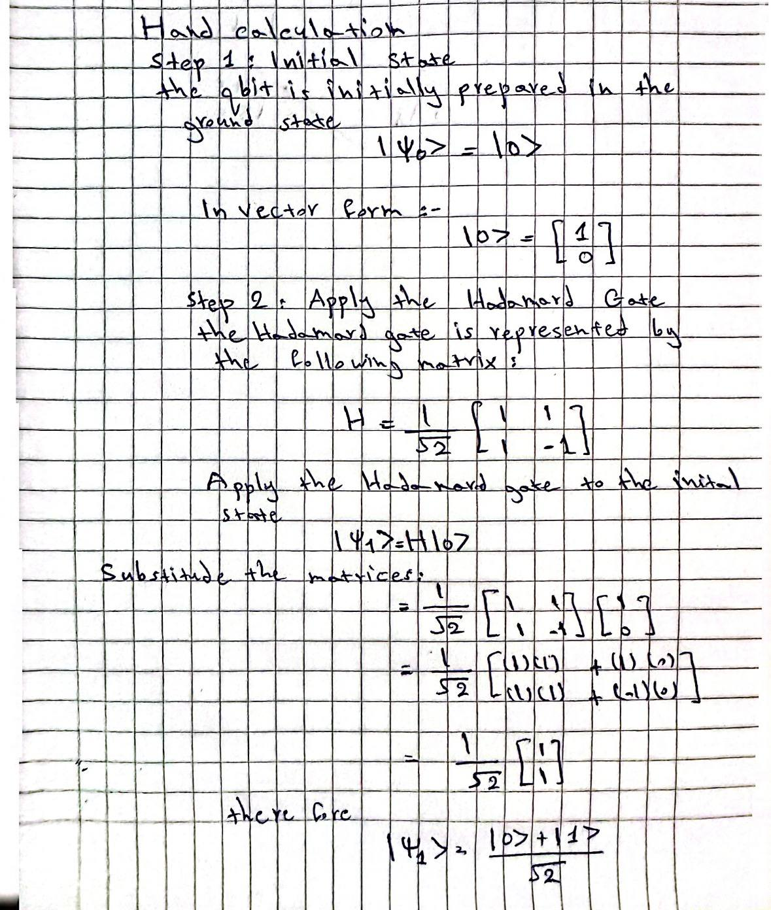
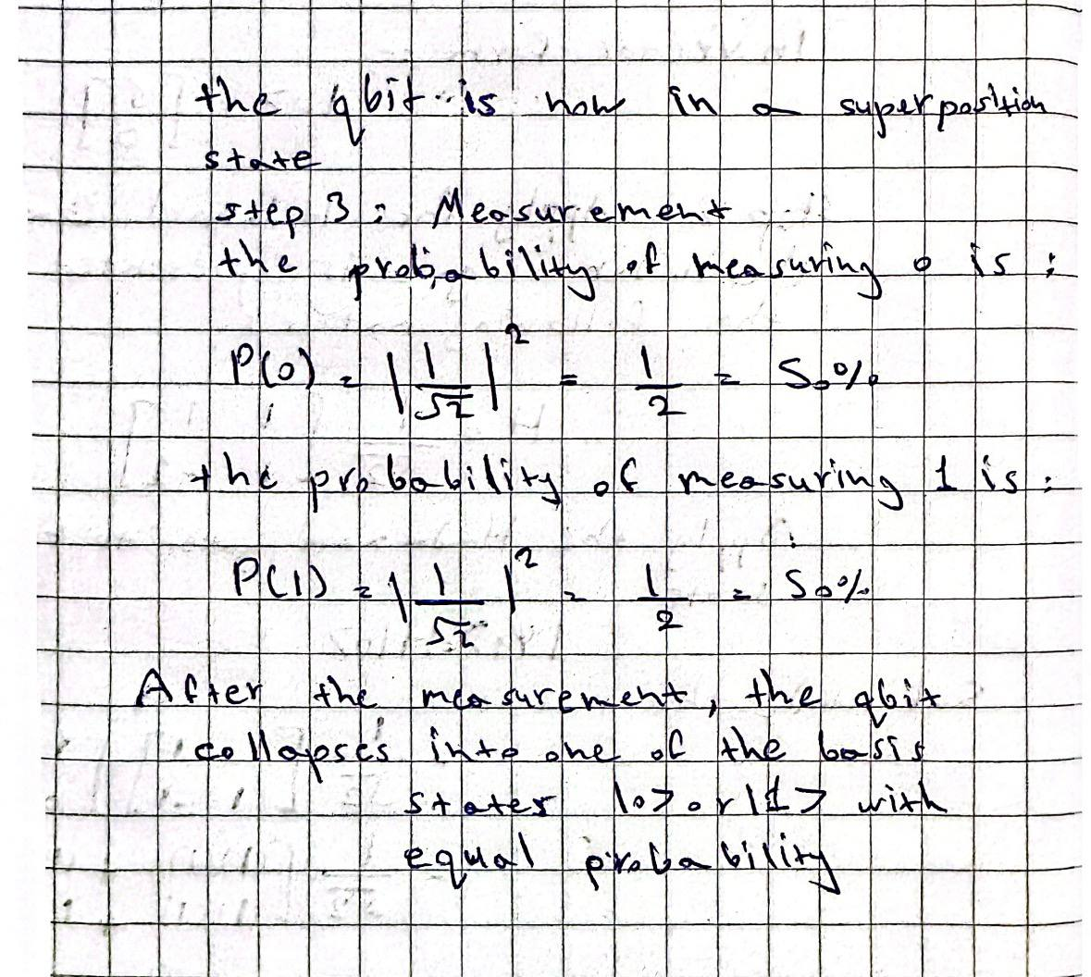
Hand Calculation

Slide 5

Conclusion
Conclusion:
The QRNG uses the principle of quantum superposition to generate truly random outcomes.
Applying the Hadamard gate places the qubit in an equal superposition of ∣0⟩ and ∣1⟩.
The measurement process collapses the qubit into either 0 or 1 with a probability of 50% for each outcome.
The Qiskit simulation produced approximately equal counts of 0s and 1s, confirming that the circuit behaves as expected.
This demonstrates that quantum computing can generate genuine randomness, unlike classical pseudo-random number generators.

